Slide 1

Adding context and cognition to modern Nlp
Dr. Catherine Havasi
Director, Common Sense Computing Initiative
Visiting Scientist, MIT Media Lab
Photo by: Allen Watkin CC BY-SA 2.0.
Photo by: Petar Milošević CC BY-SA 3.0.
Photo by: Petar Milošević CC BY-SA 3.0.
Photo by: Petar Milošević CC BY-SA 3.0.
Photo by: Petar Milošević CC BY-SA 3.0.

Slide 2
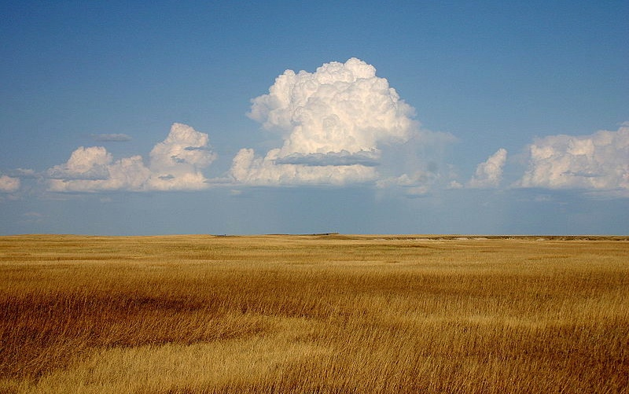




Advances have transformed language understanding.
1960s
1990s
2000s
2010s
Pattern Matching
& Keywords
Rule Sets & Ontologies
Unsupervised
ML (Bayes)
Word Embeddings
(“Deep Learning”)
Photo by: Wing-Chi Poon CC BY-SA 2.5.

Slide 3
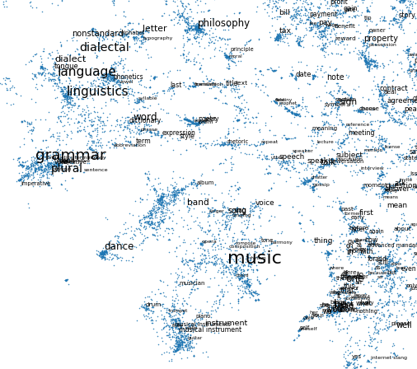
Vectors are great
Compare words by what they mean, not just exact matches
A convenient form for machine learning
Make your deep learning one step shallower
Fragment of ConceptNet 5.5
...but it matters where they came from
Notes:
Word vectors are a great representation, and I’m going to be talking a lot about a word vector representation built using ConceptNet. The image here is part of a 2-D rendering of those word vectors – you can see how connections between word meanings turn into clusters representing different general topics.

Slide 4
Distributional semantics
“You shall know a word by the company it keeps.” – J. R. Firth
a
word
by
the
company
it
keeps
Notes:
Created unsupervised from text

Slide 5






For natural language understanding to be successful, it must be:
Multilingual &
Global
Adaptable
Unbiased &
Ethical
Explainable
Automated
Notes:
This has been a revolution for Natural Langue processing.
Get confused about interchangeable words

Slide 6
“I don’t have to actually experience crashing my car into a wall a few hundred times before I slowly start avoiding to do so.”
- Andrej Karpathy, Open AI

Slide 7
How do people do it?

Slide 8
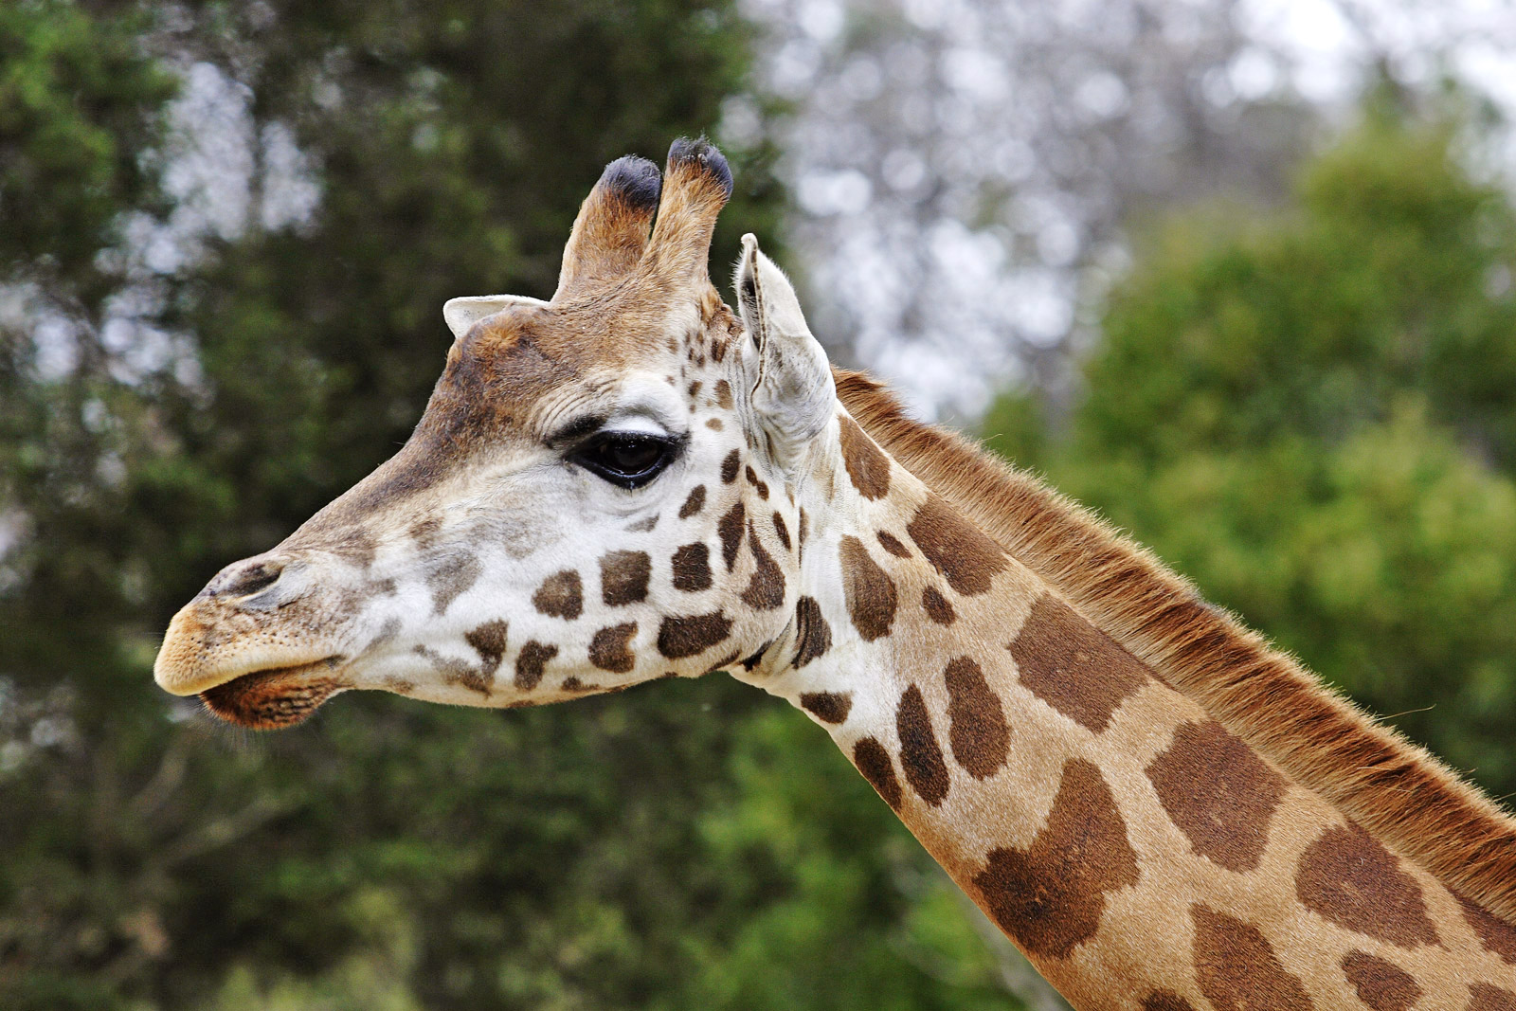
We generalize from known examples…
Photo by: Fir0002 CC BY-SA 3.0.

Slide 9
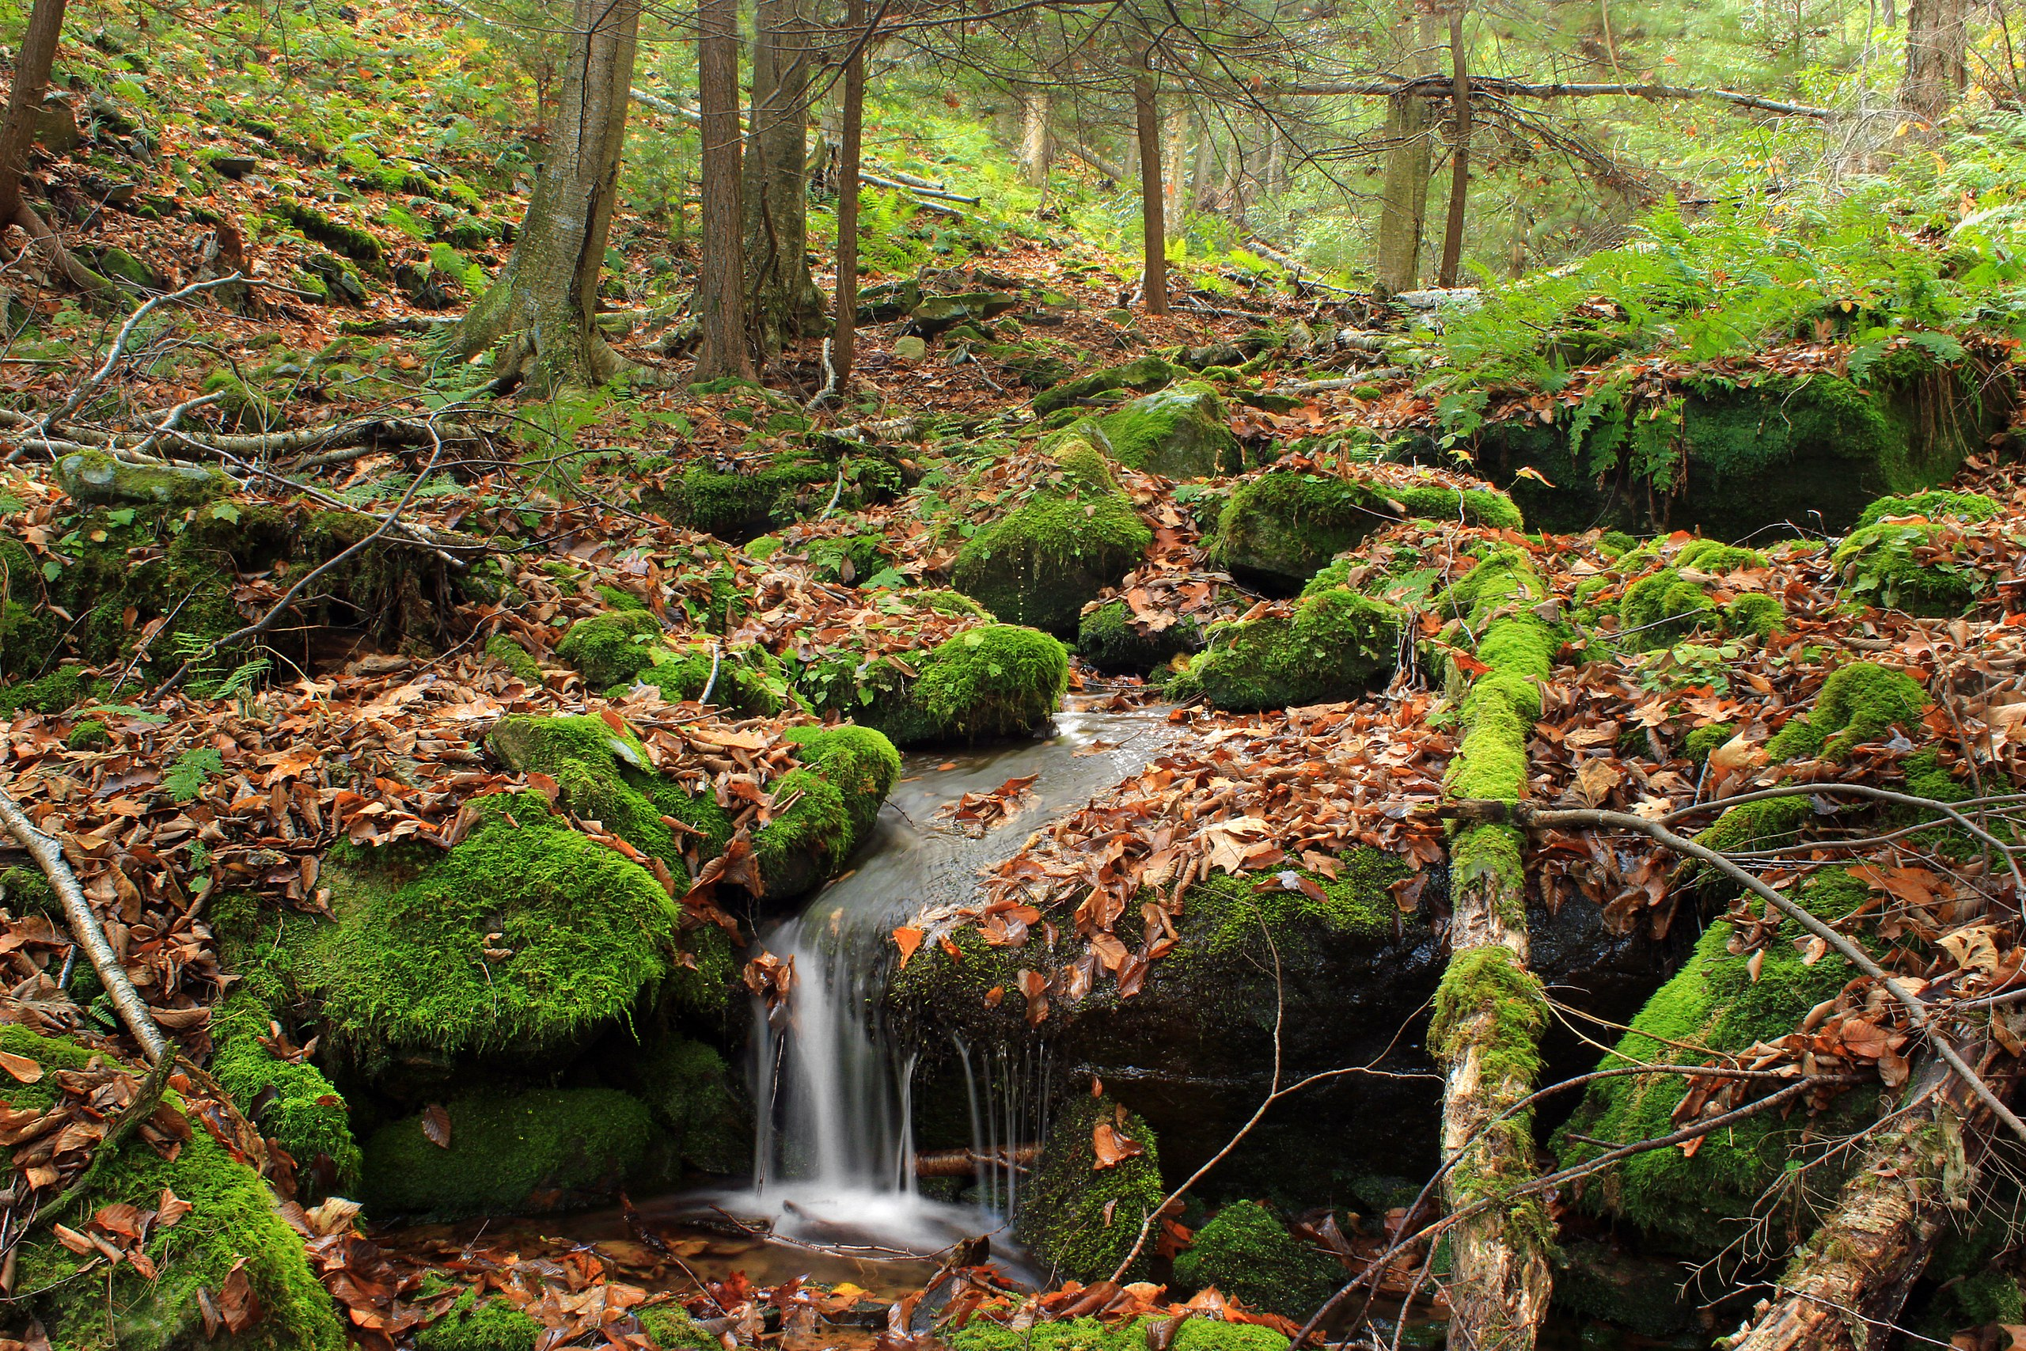
We build analogies to understand complex concepts…
Photo by: Nicholas A. Tonelli CC BY-SA 2.0.

Slide 10
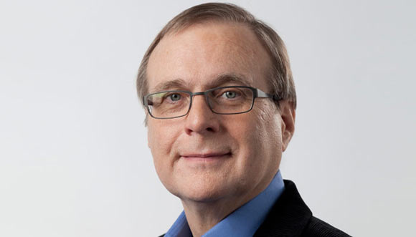
“To make real progress in A.I., we have to overcome the big challenges in the area of common sense”
- Paul Allen, Microsoft co-founder

Slide 11
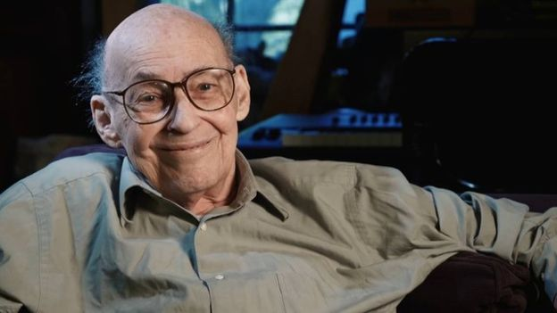
“You don’t understand anything until you learn it in more than one way.”
− Marvin Minsky

Slide 12
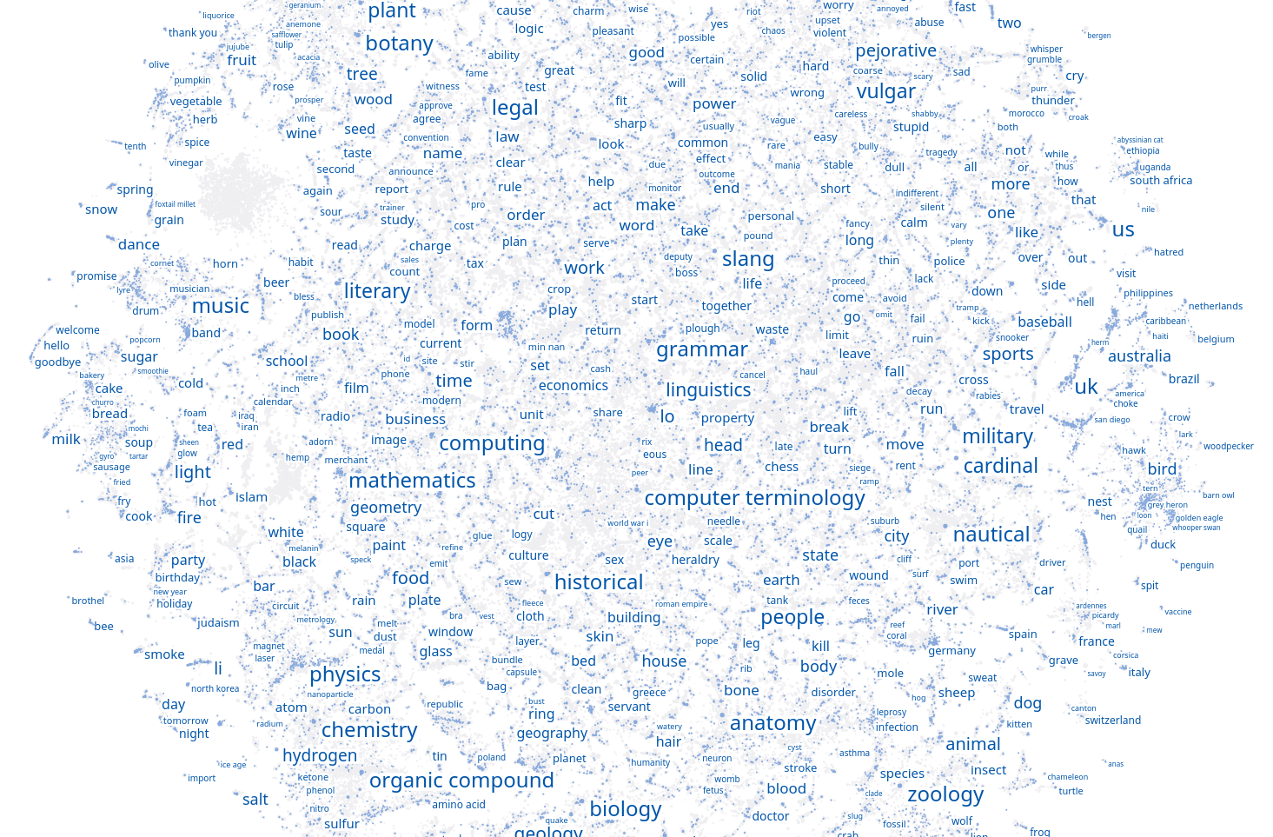
We have built models of how people think about the world in 73 languages – called ConceptNet.

Slide 13
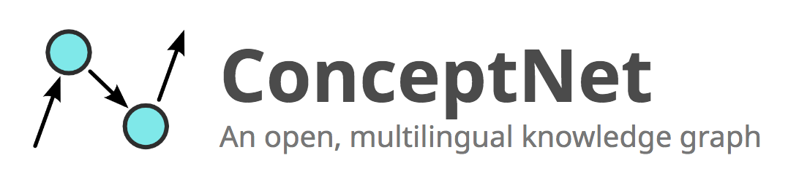

Slide 14
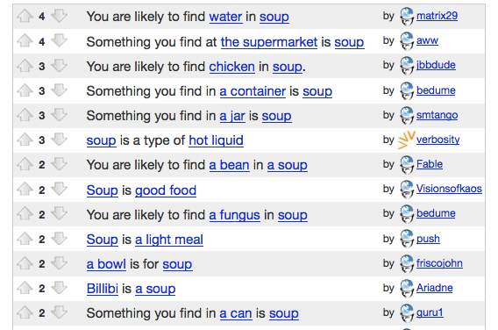
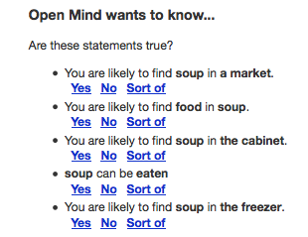
Collecting common-sense knowledge
Open Mind Common Sense,
around 2006

Slide 15
Linked data
OpenCyc
YAGO
UMBEL
Lexvo
ConceptNet
WordNet
DBPedia
UBY
Wikidata
Wiktionary
Wikipedia

Slide 16
Languages in ConceptNet

Slide 17
ConceptNet is multilingual glue
How do we get word embeddings that can be compared across languages?

Slide 18
Retrofitting
Created by Manaal Faruqui and Noah Smith in 2015
Apply knowledge-based constraints after training distributional word vectors
It works better than during training, for some reason

Slide 19
Retrofitting
Terms that are connected in the knowledge graph should have vectors that are closer together
Many extensions now, such as “antonyms should be farther apart” (Mrkšić et al., 2016)-
tree
oak
furniture

Slide 20
Retrofitting just works
On intrinsic evaluations, the top-performing systems almost always use retrofitting
If you see a purely distributional algorithm claim “state of the art on SimLex”, it may be “state of the art assuming no knowledge graph”

Slide 21

State-of-the-art word vectors
Hybrid of ConceptNet and distributional semantics
Multilingual by design
Open source, open data

Slide 22
Building ConceptNet Numberbatch
Many data sources
Google News
Common Crawl
Open
Subtitles
word2vec
GloVe
fastText
ConceptNet
Retrofit
Retrofit
Retrofit
Join
ConceptNet
Numberbatch
Reduce dimensionality
De-bias
Notes:
The dark blue symbols here are things that are already computed. For example, we aren’t Google so we don’t have the Google News corpus. But we do have what word2vec learned from the Google News corpus, so we can use that.

Slide 23
SemEval 2017
Semantic Evaluation – head-to-head evaluations of NLP systems
Systems submit results to be evaluated against unseen test labels

Slide 24
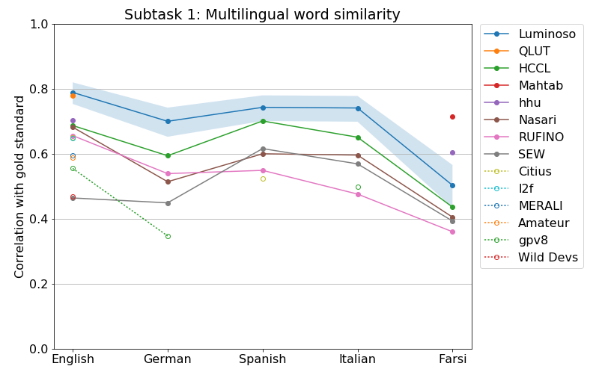
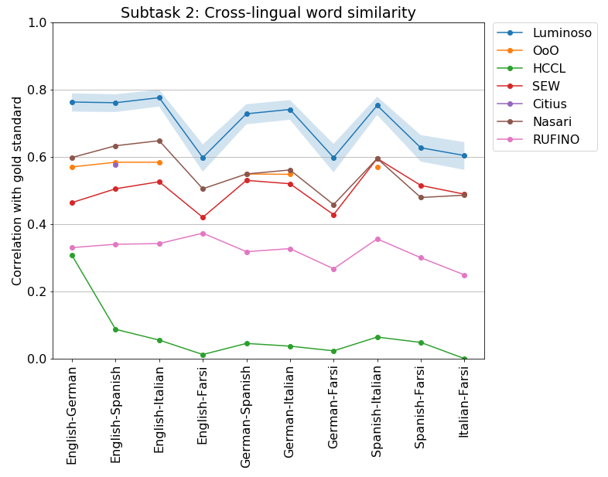
SemEval 2017 (multilingual)

Slide 25
Why ConceptNet in particular?
Represents multiple registers of knowledge
“fire is oxidation” vs. “fire is hot”
Common words are represented with lots of edges; rare words are represented at all
Avoids wasting feature space on highly specific trivia
Notes:
If you want to play Six Degrees of Kevin Bacon on your knowledge graph, you can follow the external links from ConceptNet to DBPedia, but we keep things like movie credits out of our machine learning.

Slide 26
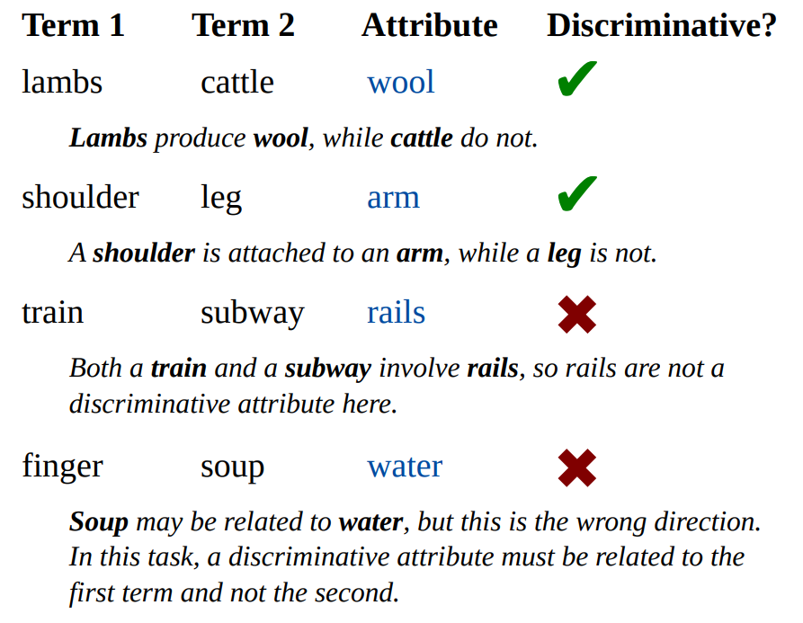
Distinguishing attributes using ConceptNet
A task at SemEval 2018
We got 74% accuracy (2nd place) by directly querying ConceptNet Numberbatch
Additional features trained on the data didn’t help on the test set
All top systems used knowledge graphs

Slide 27
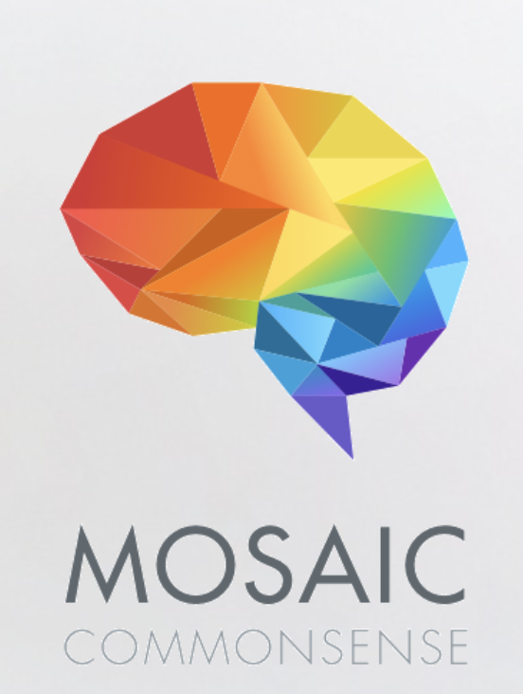
AI2 & The Mosaic Project
Initial focus on evaluations for common sense – building a common set of benchmarks to understand higher level reasoning
Collecting some data, working with DARPA

Slide 28

In order to beat a human player at chess, Google’s AlphaZero had to play 68 million games against itself.
Photo by: David Lapetina CC BY-SA 3.0.

Slide 29

You cannot simulate your call center calling itself 68 million times.
Photo by: Nebiyu.s CC BY-SA 4.0.

Slide 30
What is domain Adaptation?
customer intents,
product names,
industry jargon,
specific issues
domain
specific
data
domain
general
data
common words,
multiple languages, paraphrases, general sentiment
Notes:
In current NLP, there are lots of large, general datasets – but they aren’t the data you need to analyze.
Interesting data is often small and specific. But small data isn’t enough to train good NLP.
At Luminoso, we design software that learns from the combination of both kinds of data, providing robust understanding that solves a specific problem.

Slide 31
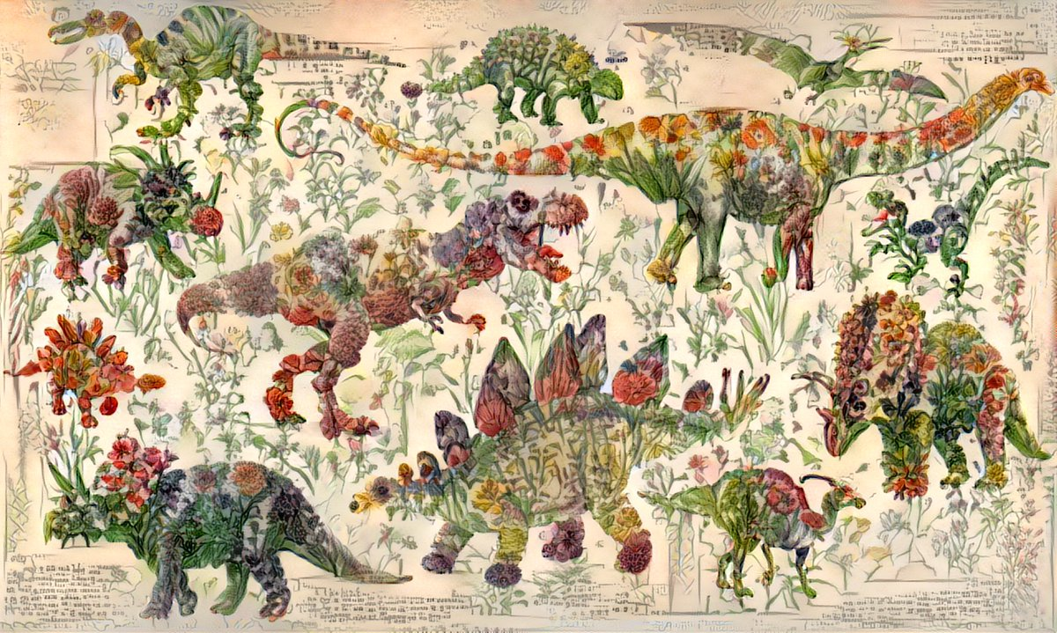
What is transfer learning?
Photo by: Chris Rodley
Photo by: Chris Rodley
Photo by: Chris Rodley

Slide 32
How do we adapt to a domain?
You probably don’t need a general NLP system, you need a specific one
Starting from scratch isn’t feasible for most applications
We can take advantage of general knowledge to quickly learn specific knowledge

Slide 33
Domain-specific learning
Text from your particular domain
NLP pipeline
ConceptNet
Numberbatch
Domain-specific
word vectors
Merge
Notes:
Now you can get useful word vectors out of even a small amount of text. You don’t have to find a billion words of domain-specific text, and you don’t have to pretend that old news is the text you really care about.

Slide 34

What is grounding?
Photo by: Evan-Amos CC BY-SA 3.0.

Slide 35
Additional Types of Common Sense
Physical common sense
Higher order reasoning
Social common sense
What about “folk” knowledge?
Pete Clark’s Aristo project

Slide 36
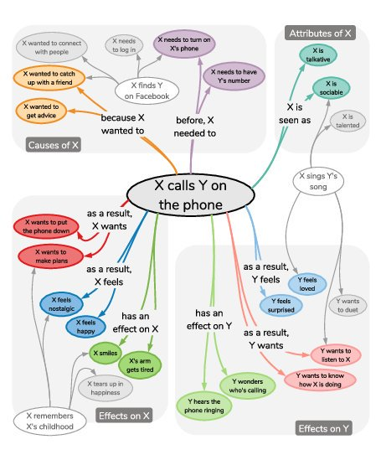
Complicated Common Sense
Allen Institute AI2
ATOMIC: An Atlas of Machine Commonsense for If-Then Reasoning
Maarten Sap, Ronan LeBras, Emily Allaway, Chandra Bhagavatula, Nicholas Lourie, Hannah Rashkin, Brendan Roof, Noah A. Smith, Yejin Choi

Slide 37
Story understanding using ConceptNet
SemEval 2018 also included a reading comprehension task, designed to require common sense
The winning system (Yuanfudao Research) used ConceptNet to find unstated connections, on top of an attention model

Slide 38
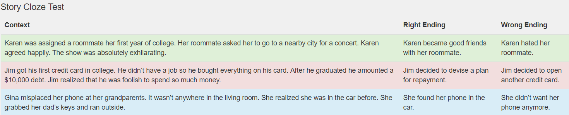
Story understanding using ConceptNet
The Story Cloze Test evaluates common sense
Five-sentence stories, two possible endings, only one makes sense
Previous state of the art (OpenAI Transformer): 86.5%
Jiaao Chen et al., adding ConceptNet as an input: 87.6%

Slide 39
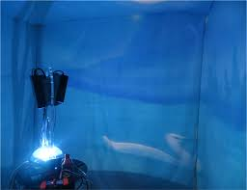
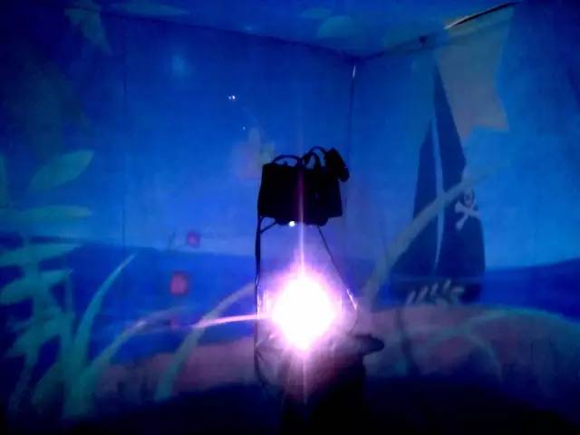
MIT’s Narratarium

Slide 40

“Society for high hanging fruit”
No one is motivated to work on very long term problems that might not be lucrative in the short term.

Slide 41
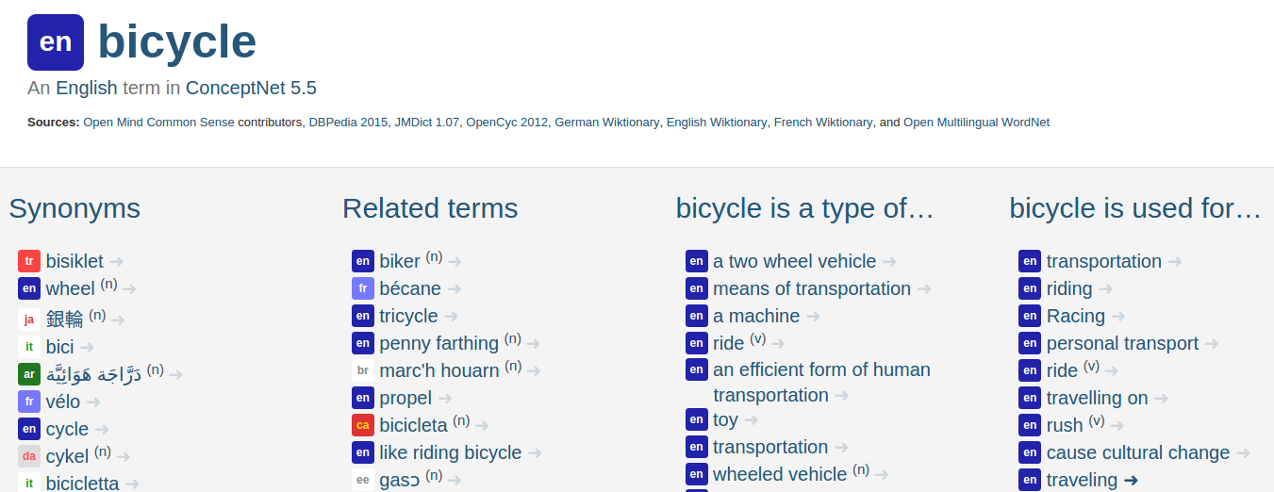
conceptnet.io – a browsable interface

Slide 42
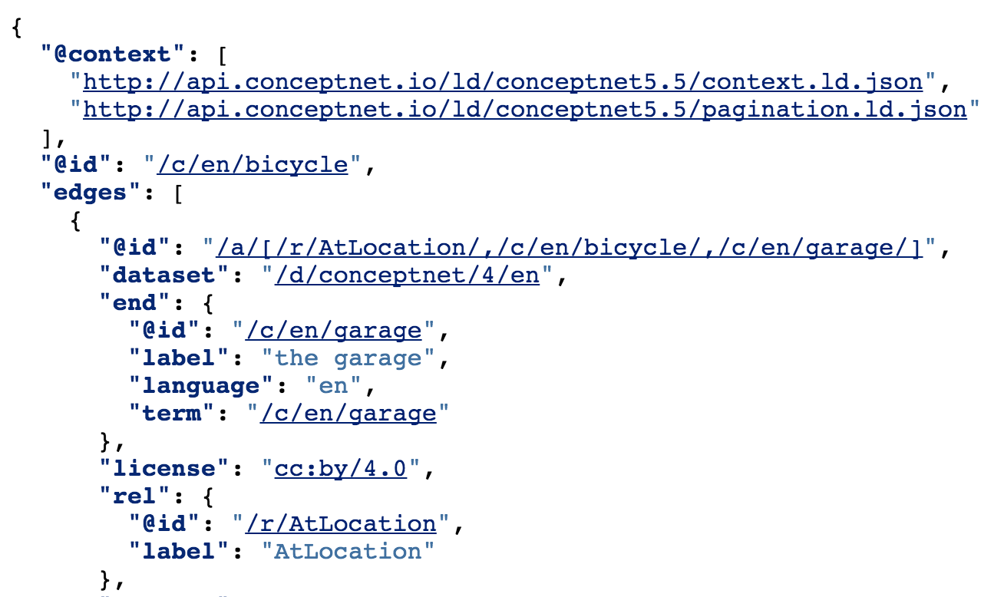
api.conceptnet.io – a Linked Data API

Slide 43
Thank you
Robyn Speer, Joanna Lowry-Duda, Robert Beaudoin, and everyone who has built, contributed to, or used ConceptNet/OMCS.
Everyone at the MIT Media Lab
Pedro Colon, Nina Lutz, Pip Mothersill, Emily Salvador and all of my patient students past and present
Jeff Foley, Ying Chen, Vivian Shih, and the amazing product & marketing teams @ Luminoso

Slide 44
I’m looking for collaborators
Dalang (digital characters) is looking for collaborators and interested parties and early stage ML talent
ConceptNet is looking for users and contributors
We may be looking for ConceptNet staff in 2019 and Creative Computation summer students - email me to be kept up to date
havasi@media.mit.edu

